Slide 1
Standard User – Maintain an Active Contract
February, 2013

Slide 2

Learning Objectives
Upon completion of this course you will be able to:
Terminate and Restore a Contract
Place a Legal Hold and Resume a Contract

Slide 3

Maintain the Contract
After the contract is executed it is monitored for compliance and performance, and if there are issues the contract may be:
Placed on Hold (and released when issues are resolved)
  The contract status becomes On Hold.
Terminated
  This may be chosen if, for example, the external party goes bankrupt and can't fulfill the contract.
  The contract status becomes Terminated.
For both of these changes it is very useful to update the Substatus to provide additional information on the change.

Slide 4

Terminate an Active Contract
You can terminate an Active or Executed contract from any tab of the Contract Editor.
Click the Terminate icon on the main, blue toolbar.
The Terminate Contract dialog box is displayed.

Slide 5
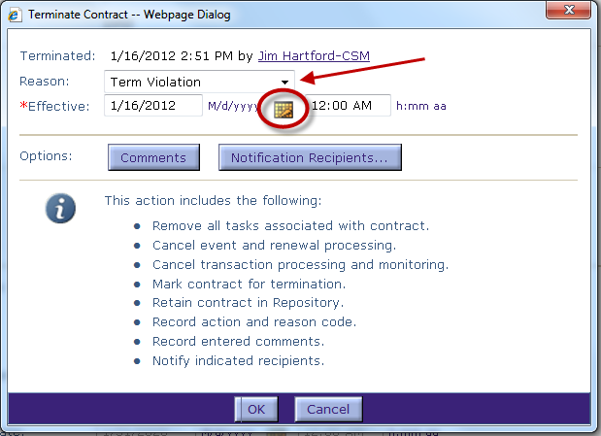
Terminate an Active Contract
When terminating a contract, you need to identify the reason and then set the effective date of the termination.
Click the Reason drop down menu and select a reason from the list.
Enter the Effective date or click the Calendar icon to select the date.
The information box displays the actions that occur when a contract is terminated.

Slide 6
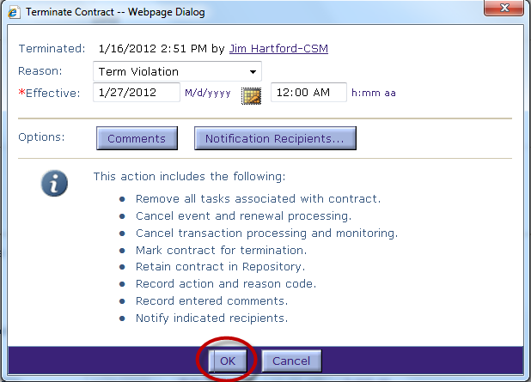

Terminate an Active Contract, cont.
Enter Comments to further explain the termination violation.
  Click the Comments button and enter as much detail as possible.
You can also set which recipients to notify about the contract termination.
  Click the Notification Recipients button to select the individuals.
Click OK to terminate the contract.
The contract status is now set to Terminated. However, you may want to edit the contract substatus value to better reflect this change.

Slide 7
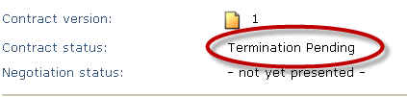
Terminated Contract
The contract now appears with the status of Terminated
  (If the effective termination date has not passed, the status will be Termination Pending until that date is reached)

Slide 8

Place a Contract On Hold
Click the Hold icon on the main, blue toolbar.
The Hold Contract dialog box is displayed.

Slide 9
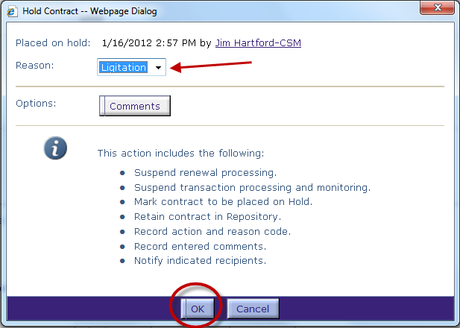
Hold Contract Dialog Box
Select the Reason for the Hold from the drop-down menu. These are configurable by the client.
Click the Comments button to enter a comment about the Hold.
Click OK to place the contract on hold.
The Information section of the form displays the actions that occur when you place a contract on hold.

Slide 10
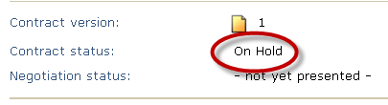
Status Change
The Contract status has been changed to On Hold.

Slide 11

Release a Contract On Hold
Click the Release icon on the main, blue toolbar.
The Release Hold dialog box is displayed.

Slide 12
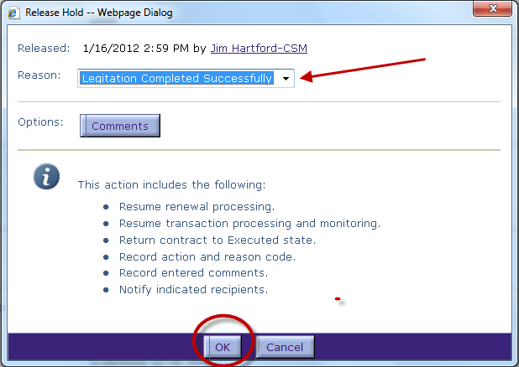
Release Hold Dialog Box
Select the Reason from the drop-down menu.
Click the Comments button to enter a comment about the release.
Click OK to release the contract.
The status is re-set to Active or Executed as appropriate.

Slide 13

Questions?

